Slide 1

Azure CI/CD pipelines
Continuous Integration & Continuous Deployment
with Azure DevOps

Slide 2

“One Company”

Slide 3
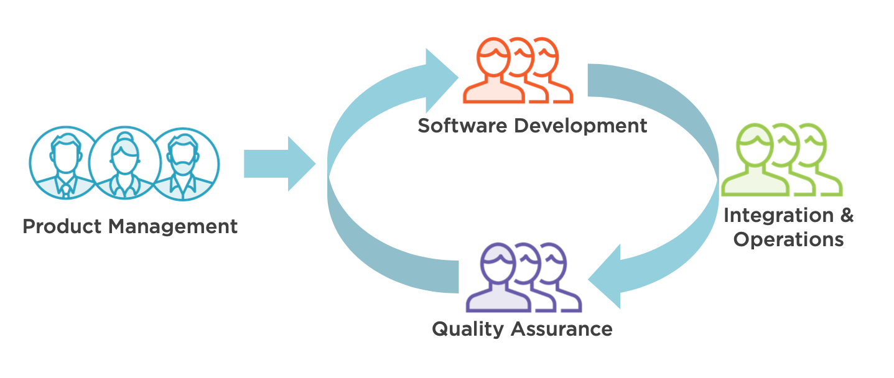
How software gets created

Slide 4
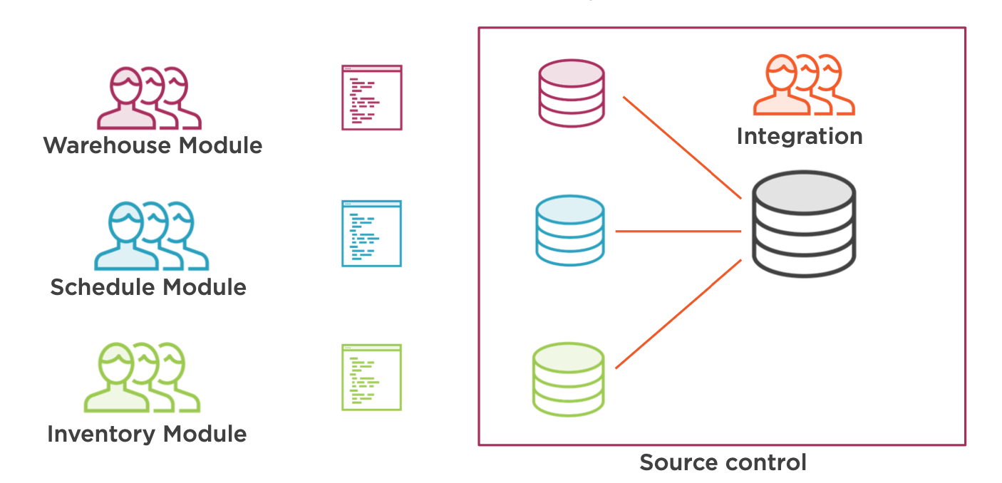
Software development process

Slide 5
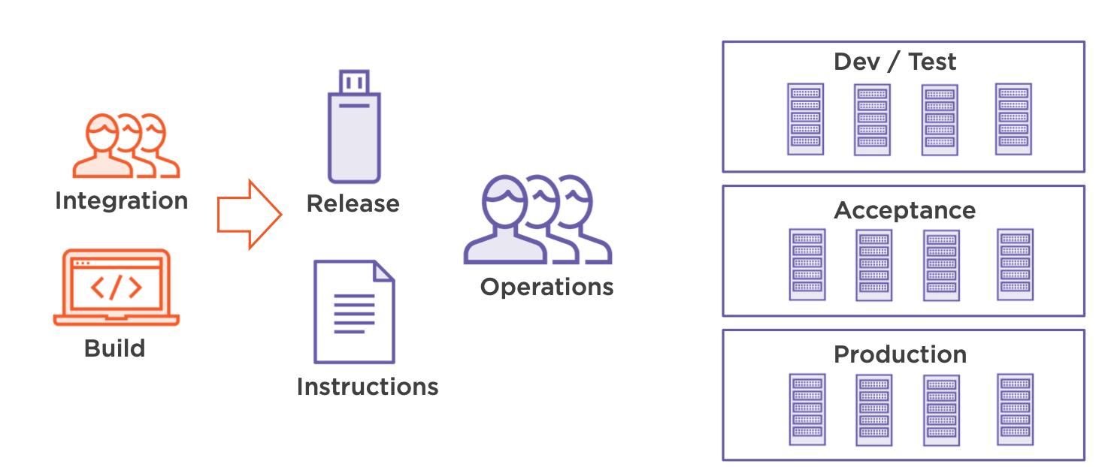
Deployment process

Slide 6
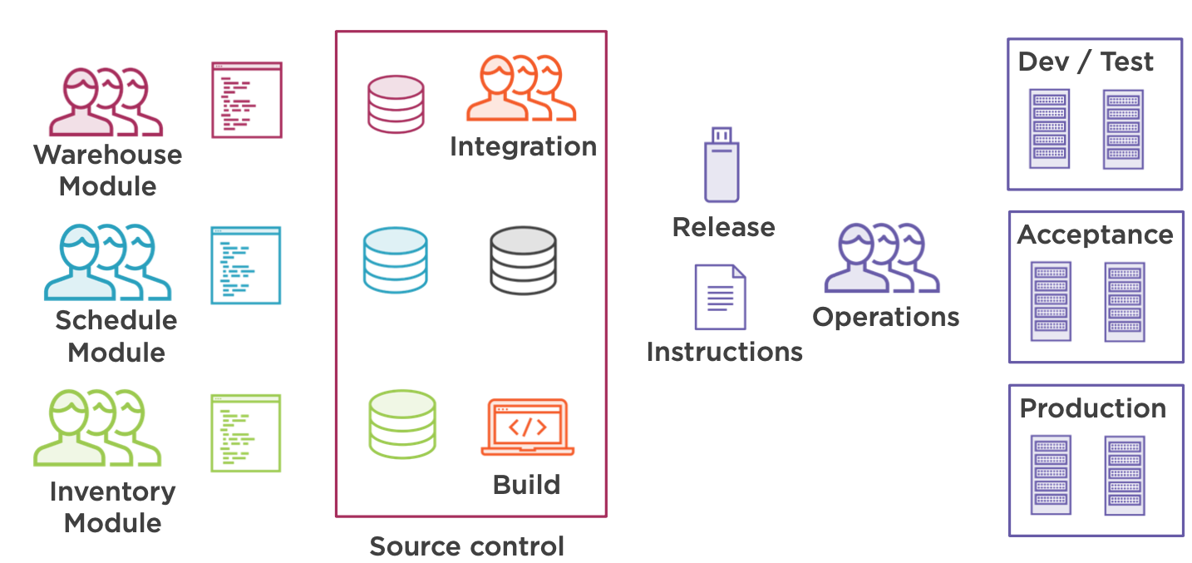
Software development & deployment
What problems can they face ?

Slide 7
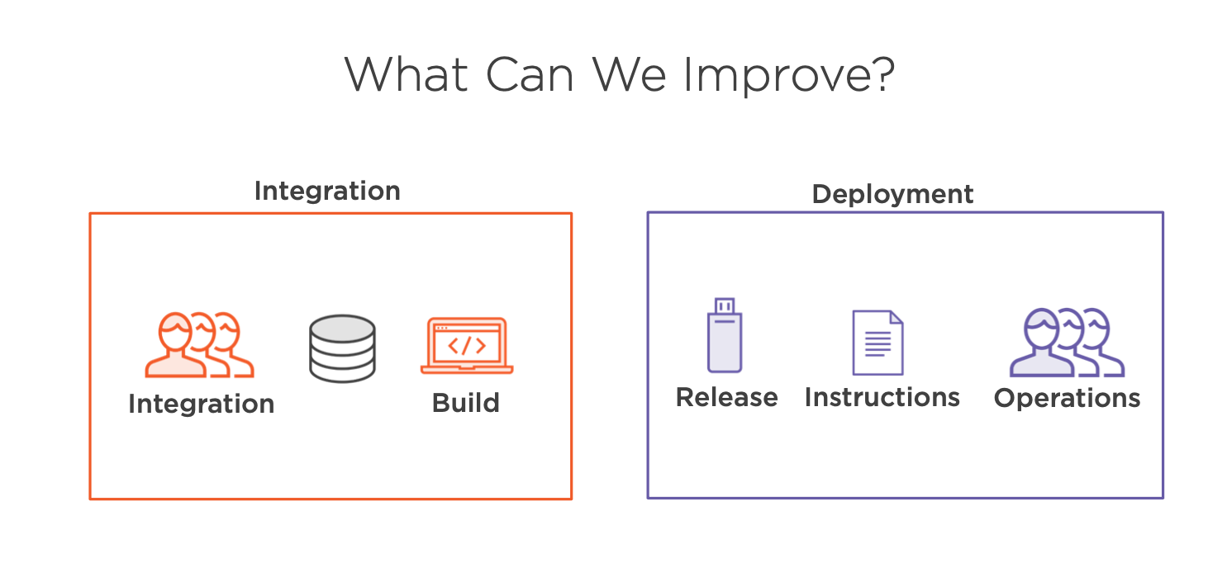
How to improve …
Using - Continuous integration
Using - Continuous delivery

Slide 8
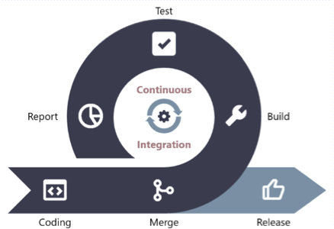
Continuous Integration
CI is the practice of merging all developers' working copies to a repository several times a day!

Slide 9
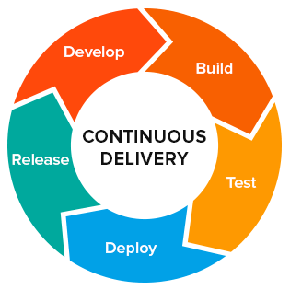
Continuous delivery
CD is a software development discipline where software can be released to production at any time

Slide 10
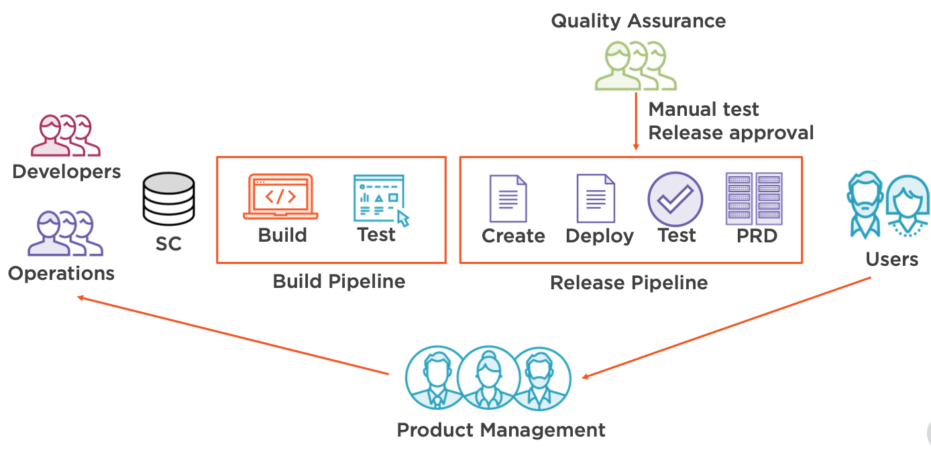
Continuous delivery

Slide 11
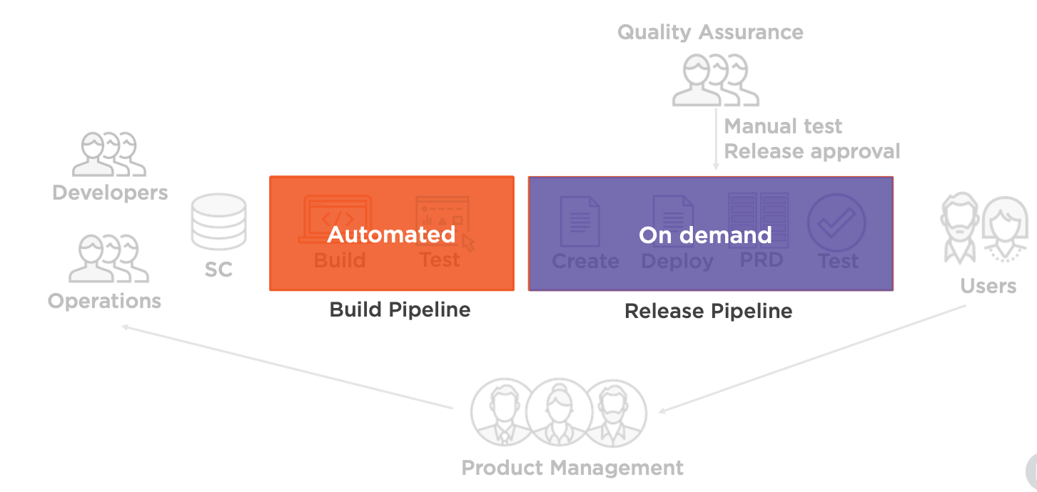
Continuous delivery

Slide 12
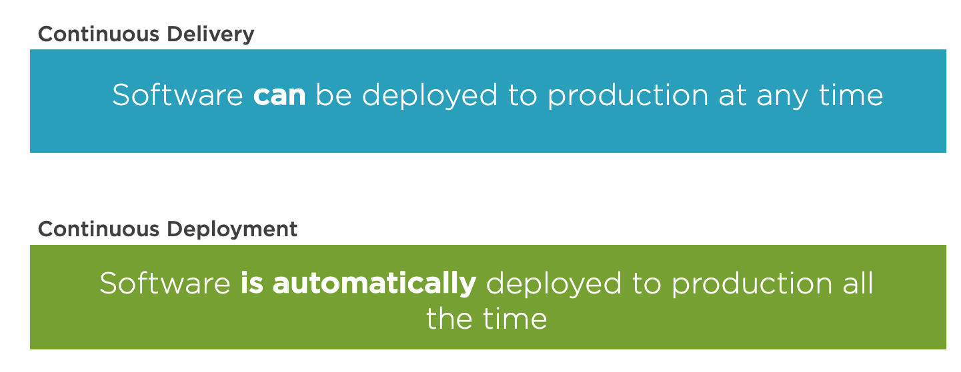
Difference between Delivery and Deployment

Slide 13

Quiz time!

Slide 14

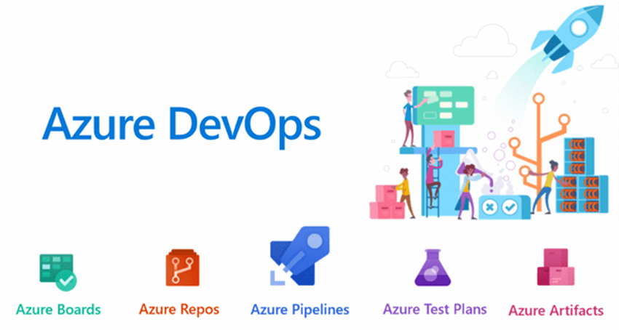
Data Locations: Australia, Brazil, Canada, Asia Pacific, Europe (EU), India, United Kingdom, United States (US)
Notes:
Azure DevOps ( Server )
is a Microsoft product that provides version control , reporting, project management (for both agile software development and waterfall teams), automated builds, testing and release management capabilities.

Slide 15
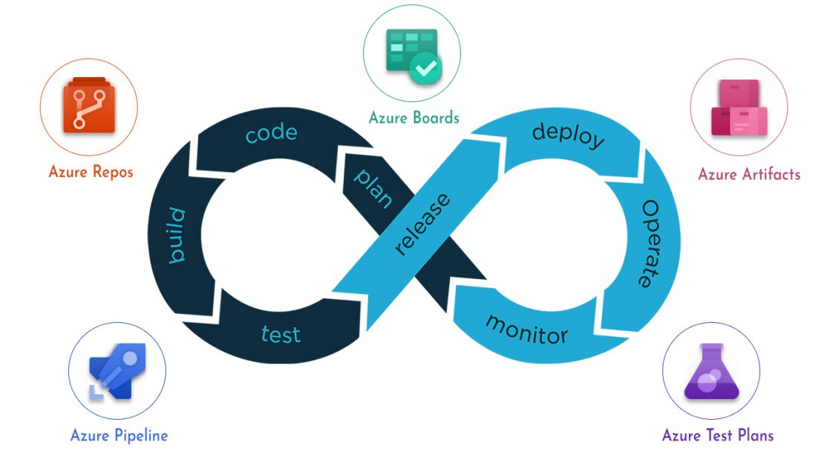

Slide 16
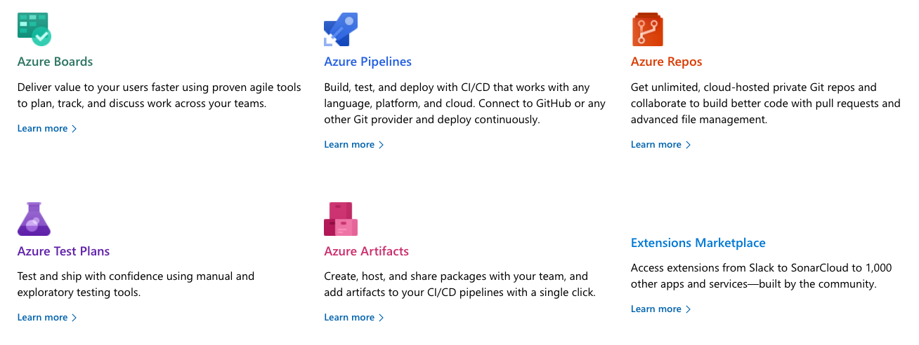
Azure DevOps Components

Slide 17
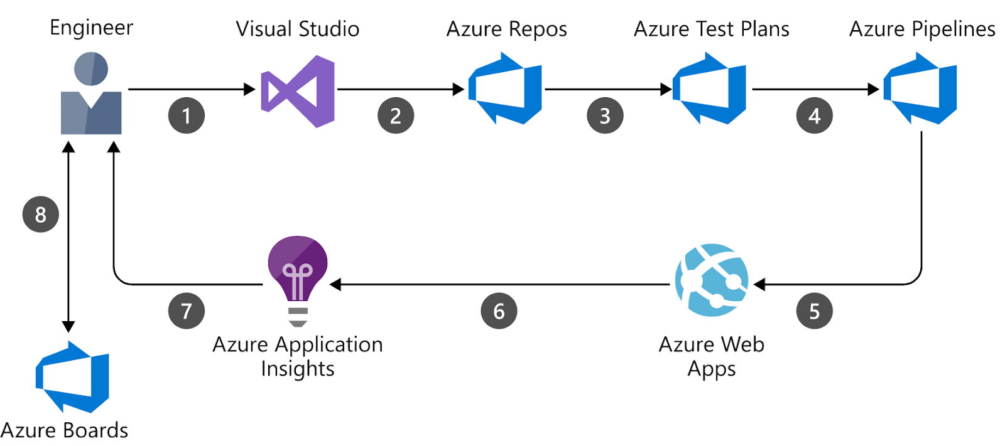

Slide 18
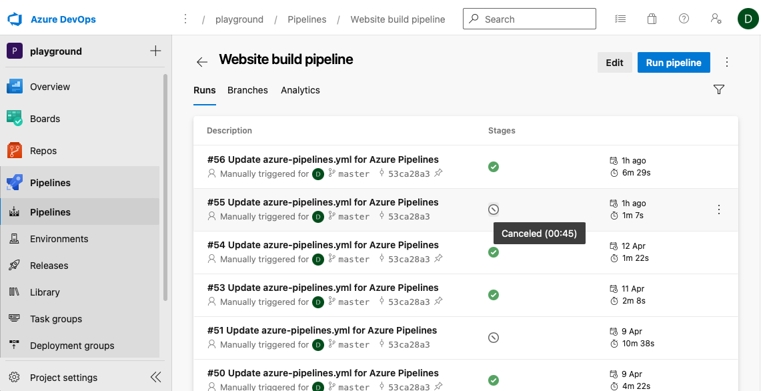
Azure DevOps portal

Slide 19
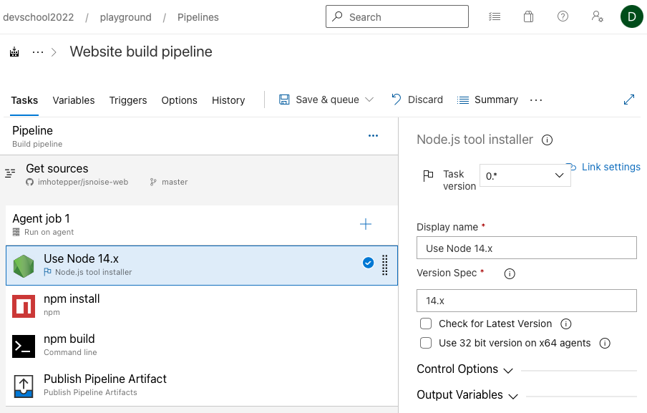
Classic pipeline

Slide 20
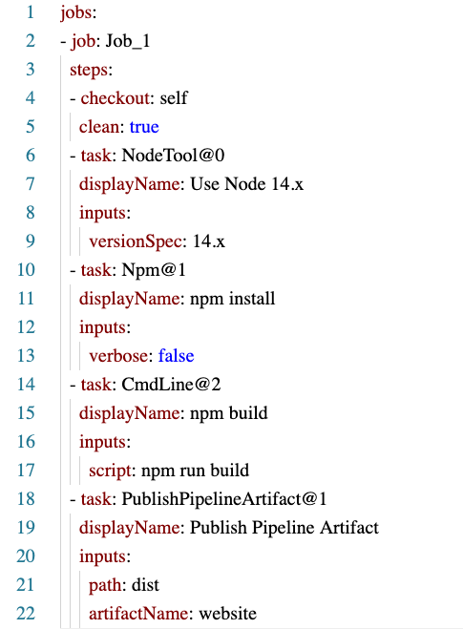
YAML pipeline

Slide 21
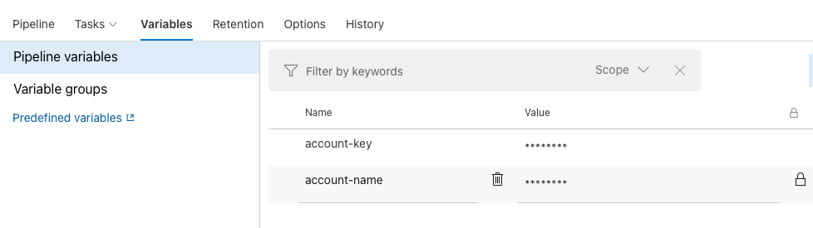
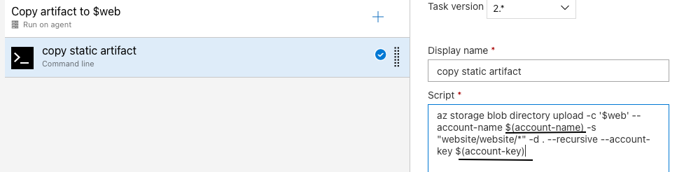
Pipeline Variables

Slide 22
Predefined Variables
Agent | Build | Deployment | System
Agent.OS | Build.ArtifactStagingDirectory | Environment.Name | System.AccessToken
Agent.BuildDirectory | Build.BuildNumber | Environment.Id | System.CollectionUri
Agent.JobName | Build.Repository.Uri | Environment.ResourceName | System.DefaultWorkingDirectory
Predefined variables - Azure Pipelines | Microsoft Docs
Notes:
Power Shell: get-childitem –path env:*

Slide 23
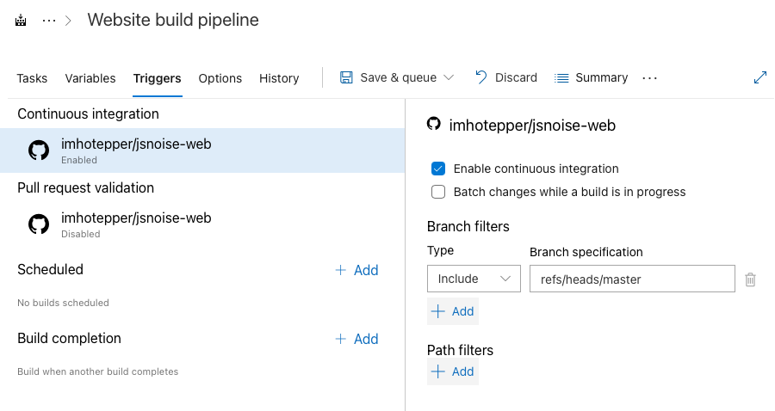
Triggers / Continuous Integration

Slide 24
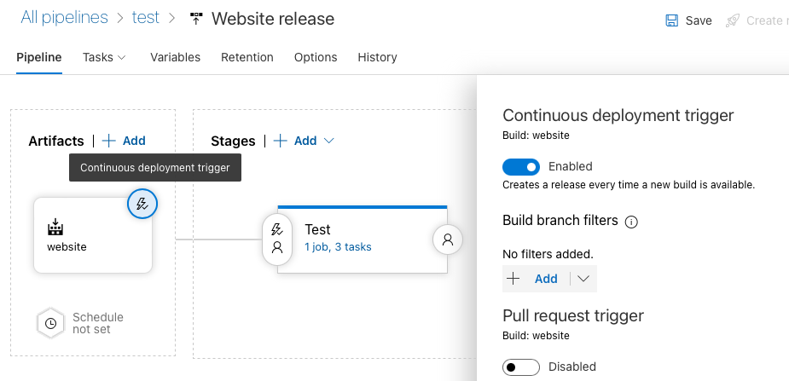
Continuous Deployment

Slide 25
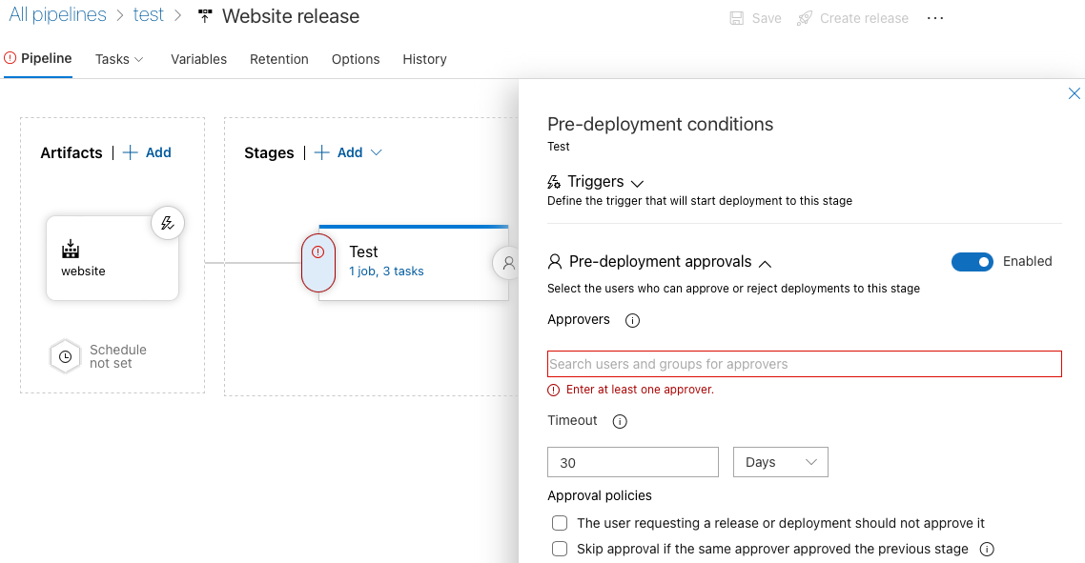
Release approvals

Slide 26
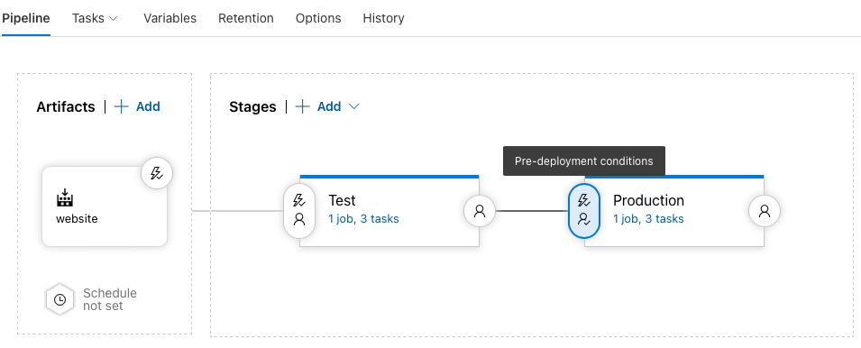
Multi-stage Release pipeline

Slide 27
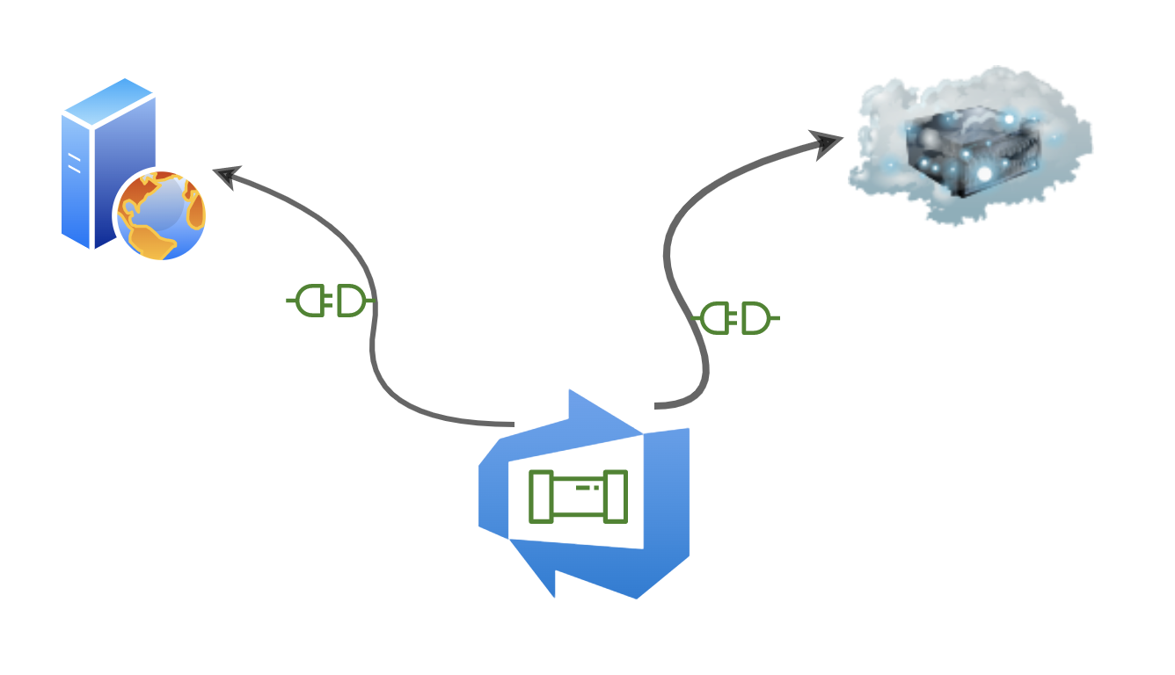
Service connection

Slide 28
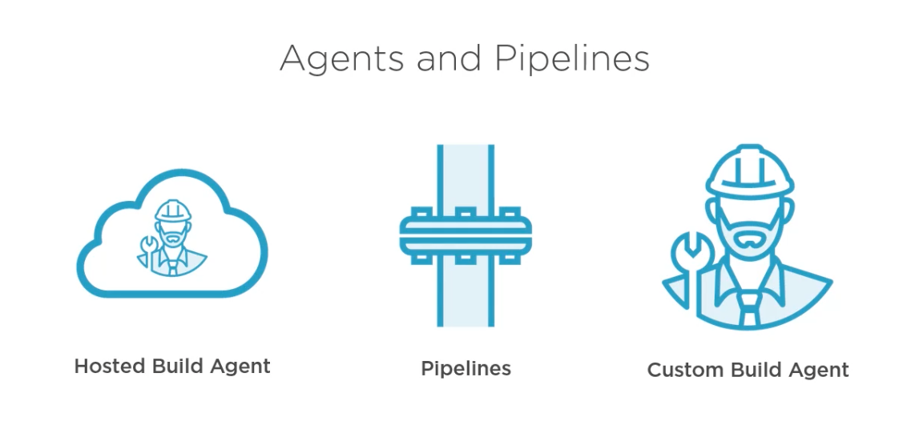
Hosted Agents

Slide 29
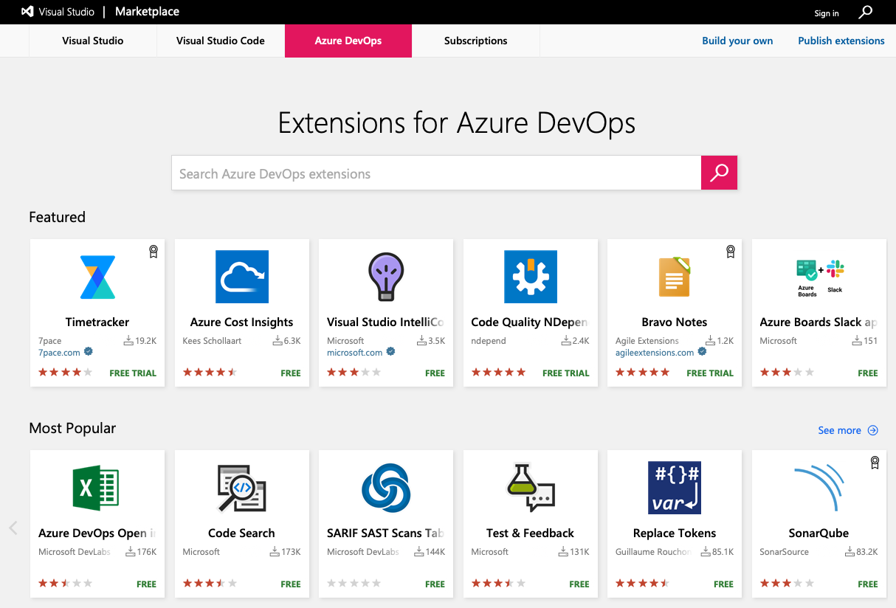

Slide 30
Quiz time!

Slide 31

Workshops time!

